Slide 1
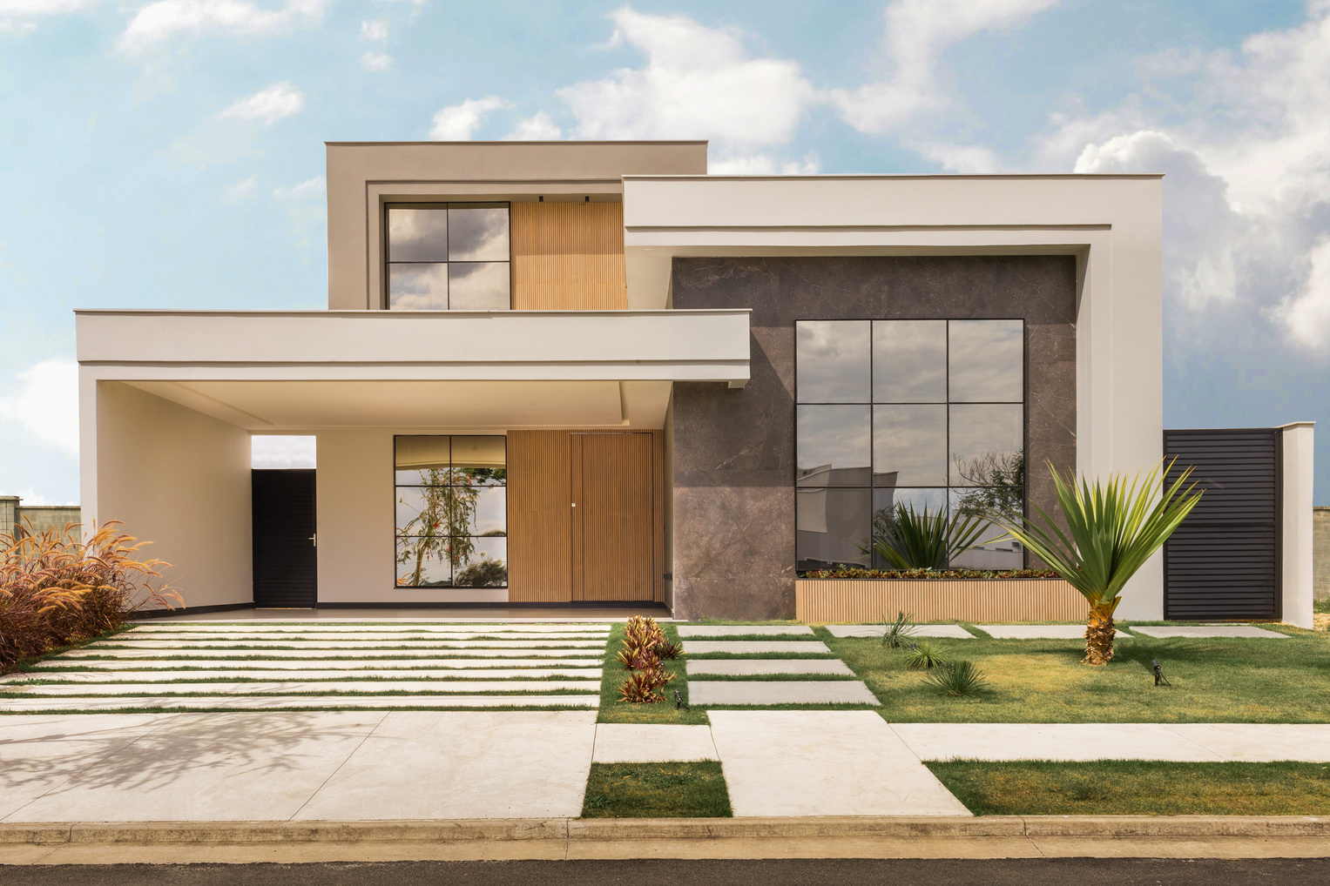
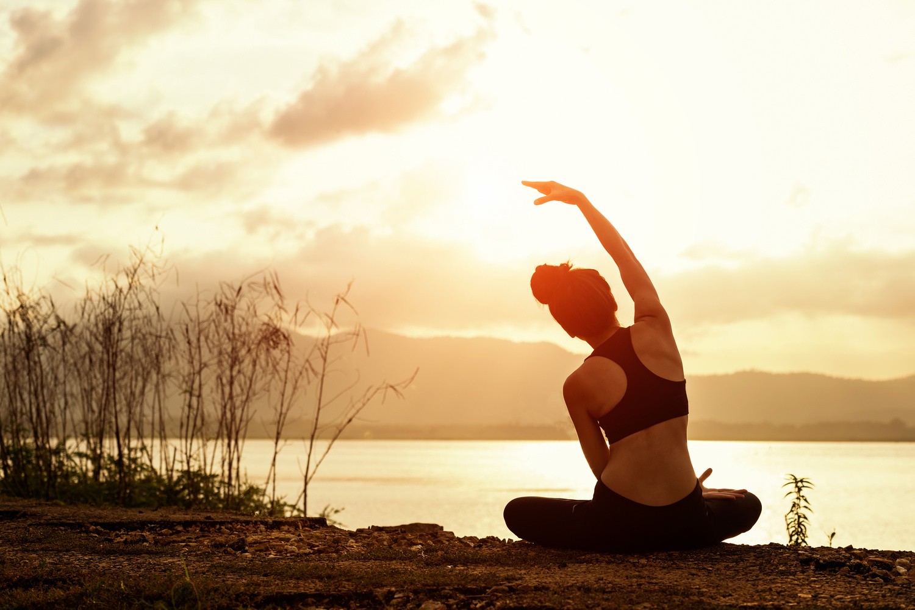
JV VENTURES
When you click the image it will take you to the home building portion of the website
When you click the image it will take you to the retreat portion of the website

Slide 2
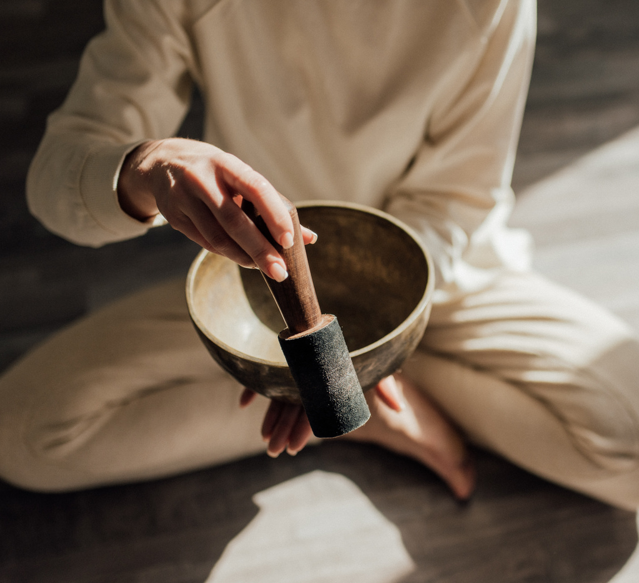

Welcome Message
Welcome to JV Ventures Retreats, where personal transformation meets empowerment. My journey began during the unprecedented times of the Covid-19 pandemic, when the world seemed to slow down, and introspection became a
necessity rather than a luxury.

Slide 3
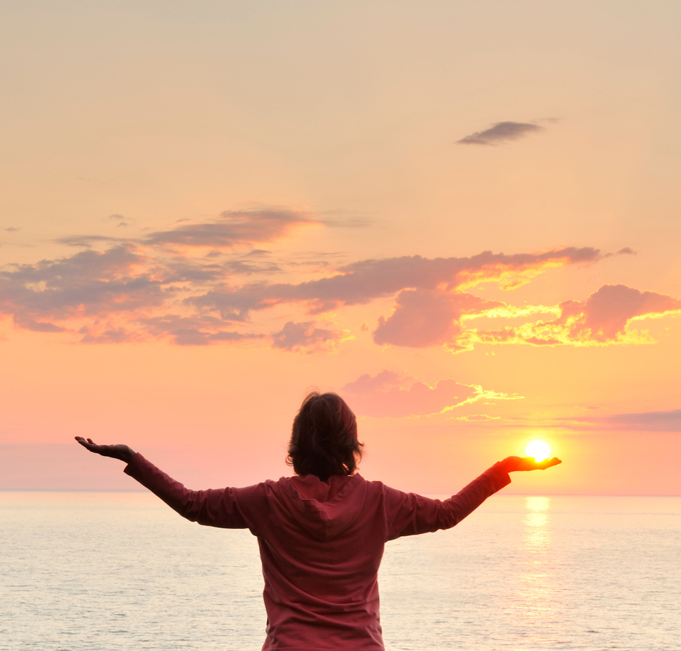
The Awakening
Like many, I found myself facing unexpected challenges and uncertainties as the pandemic unfolded. The disruptions to daily life forced me to pause, reflect, and reevaluate my priorities. It was during this time of introspection that I embarked on a profound journey of self-discovery and awakening.
As the world around me shifted, I realized the opportunity for growth that lay within the chaos. I embraced change with an open heart and an open mind, seeking wisdom in moments of solitude and solace in the beauty of nature.
Through meditation, mindfulness practices, and self-reflection, I began to uncover deeper truths about myself and my purpose in life.

Slide 4
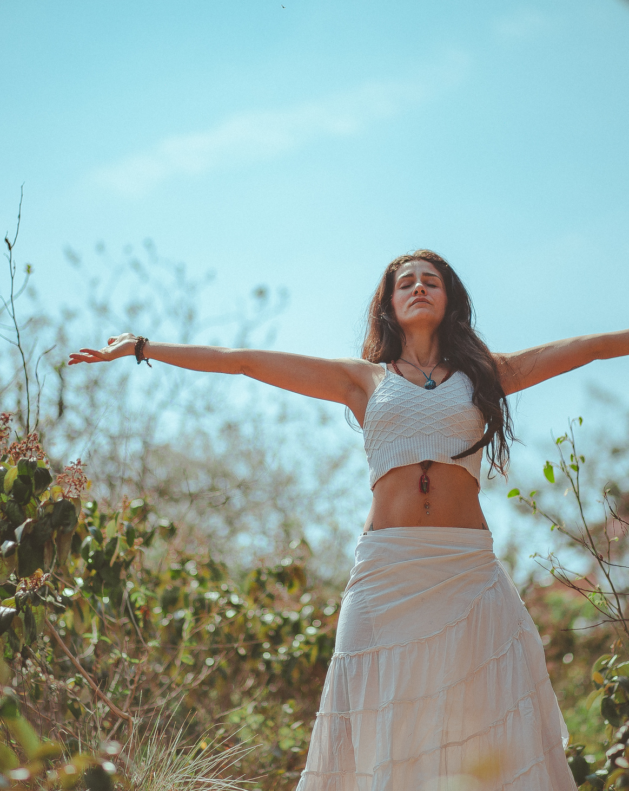
Finding Purpose
The challenges of the pandemic served as a catalyst for profound inner transformation. I discovered a newfound sense of clarity, purpose, and alignment with my authentic self. It was through this process of
self-discovery that JV Ventures was born, a platform dedicated to empowering others on their own journey of personal growth and fulfillment, by teaming up with the people and teachers that I discovered along the way, and can nowshare with others.

Slide 5
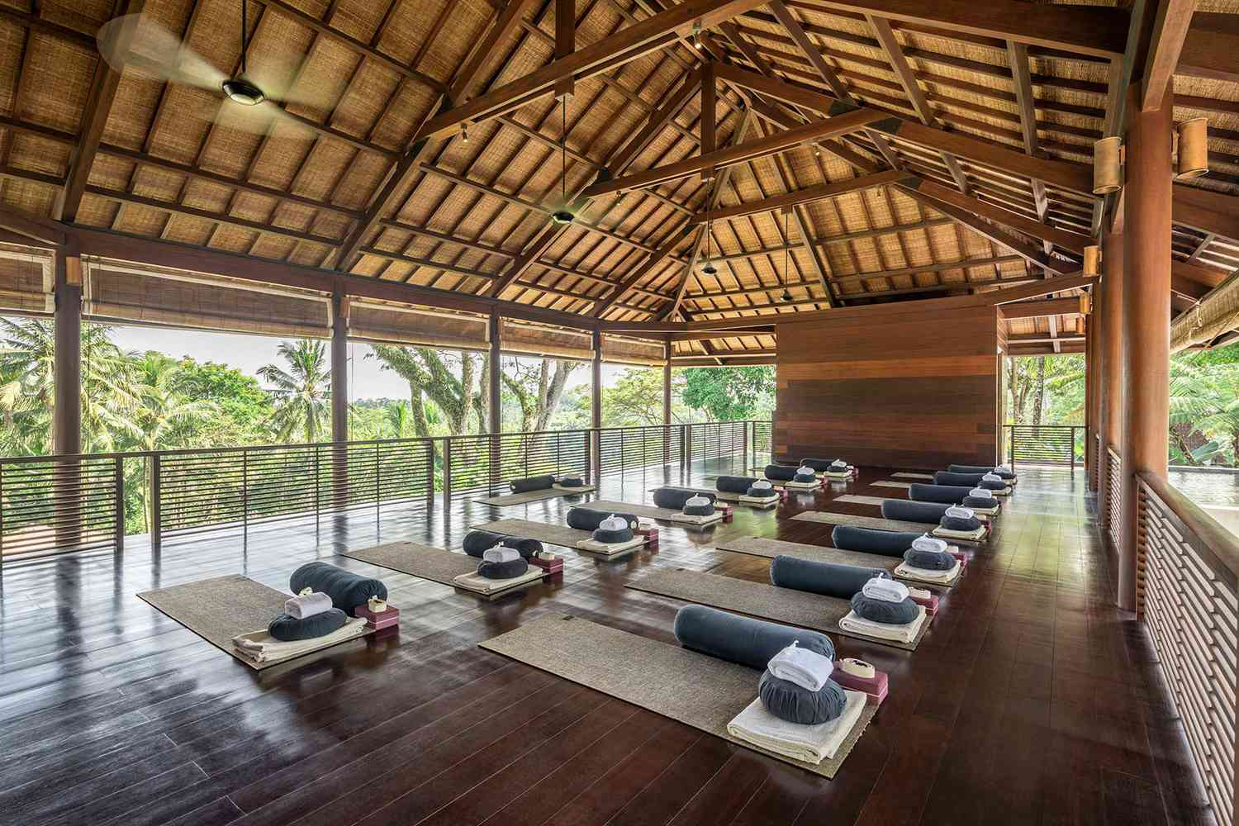
Retreats

Slide 6
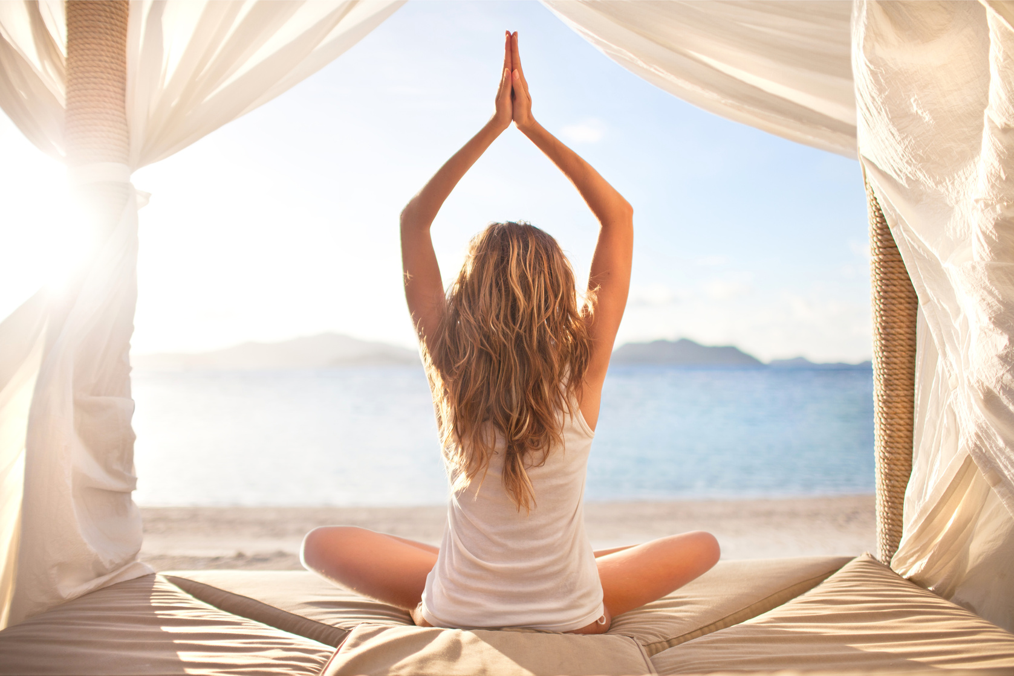
Retreats
In the bustling rhythm of modern life, it's easy to get caught up in the whirlwind of tasks and responsibilities, losing touch with ourselves and
each other along the way.
That's why we're excited to introduce various themed retreats: from women's only, co-ed, couples, business and youth, so whatever your need, we have a retreat for you. This is a dedicated time to pause, reflect, and recharge.

Slide 7
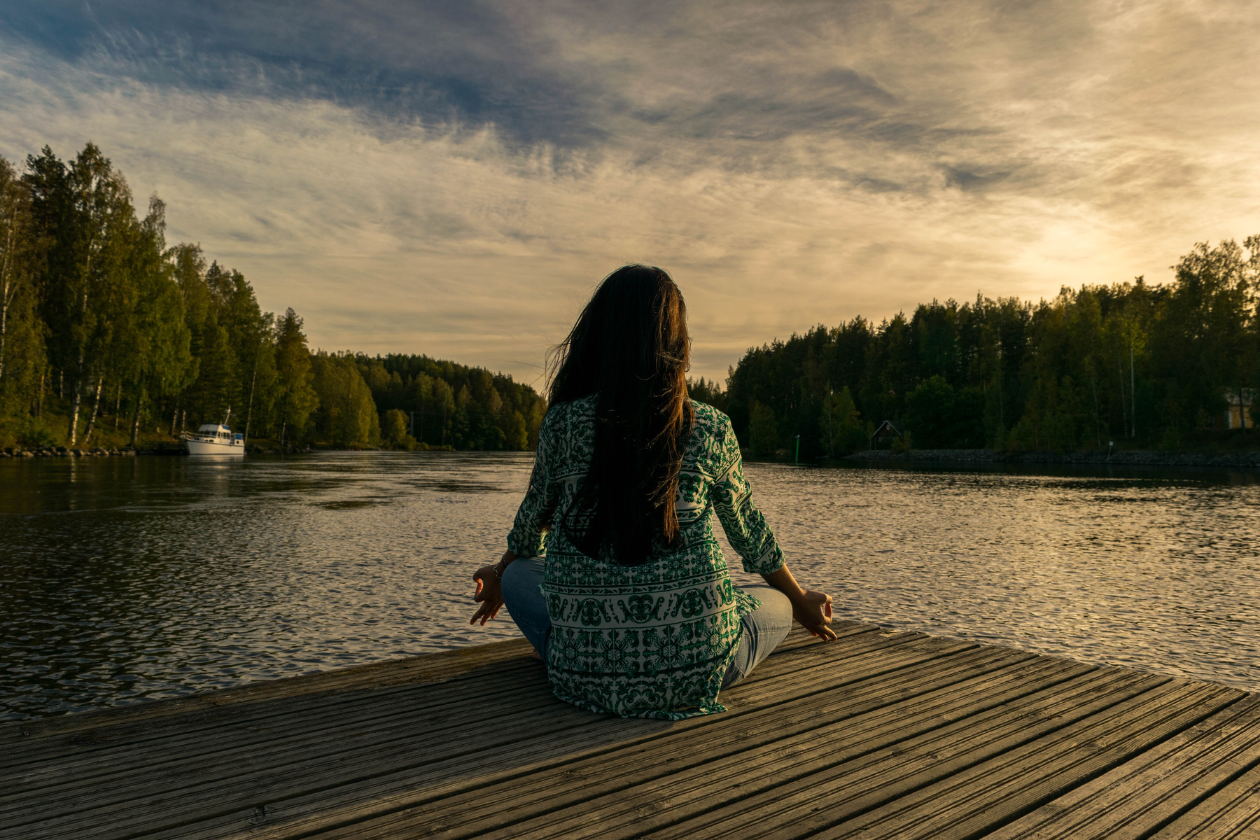

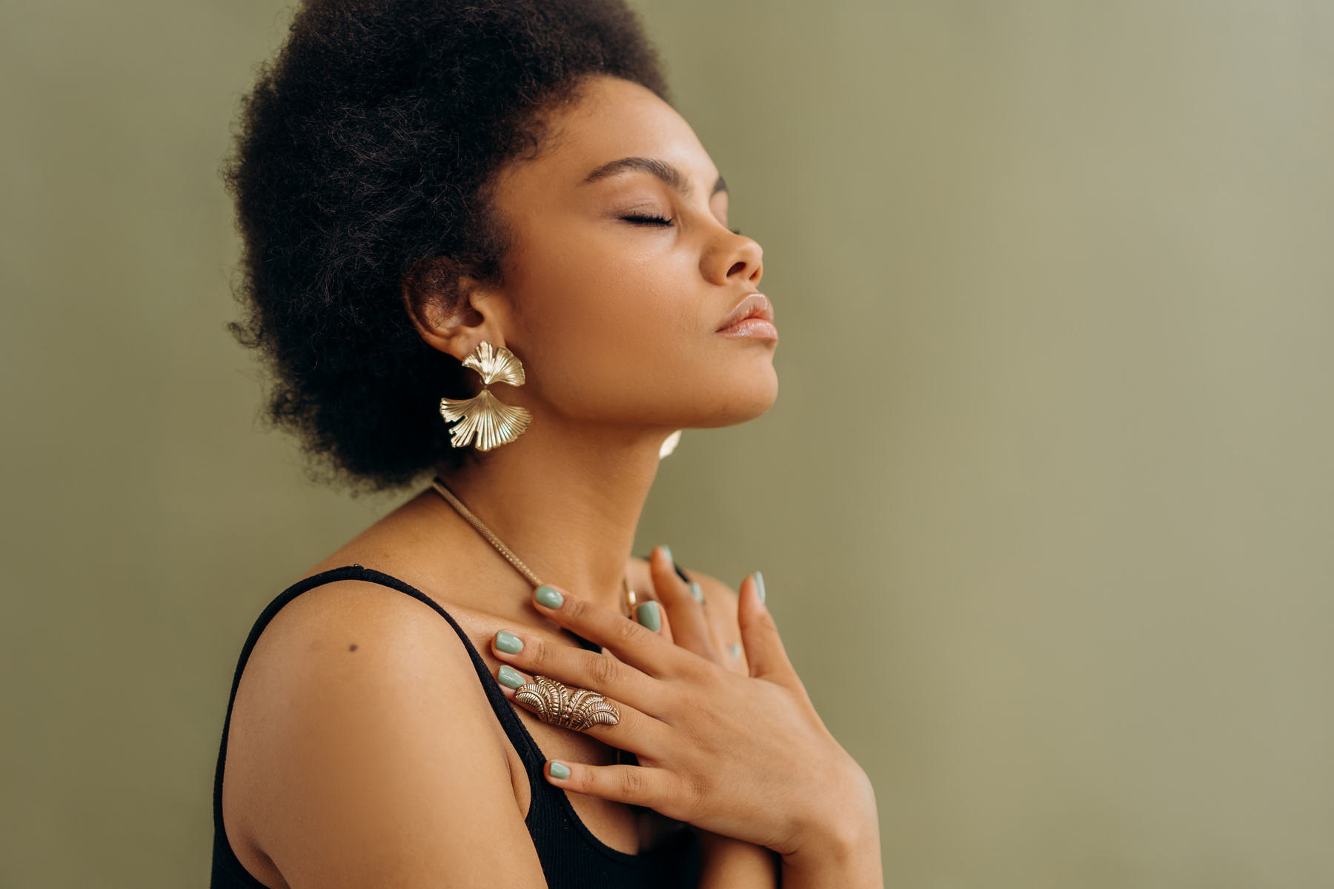
Retreats aren't just a luxury; they're a necessity in today's fast-paced
> world. Here's why
1.Rejuvination
2.Reflection
3.Connection
Retreats provide an opportunity to step away from the daily grind and immerse ourselves in a nurturing environment. Whether it's a serene natural setting or a cozy retreat center, the change of scenery offers a chance to reset and replenish our energy reserves.
Amidst the hustle and bustle, it's essential to carve out moments for introspection. Retreats offer dedicated time for self-reflection, allowing us to gain clarity on our goals, values, and priorities. By disconnecting from distractions, we can tune into our inner
voice and chart a course that aligns with our authentic selves
In our digitally connected yet emotionally distant world, retreats foster meaningful connections. Away from screens and status updates, we engage in deep conversations, shared experiences, and genuine human connections. Whether with colleagues, friends, or fellow retreat
participants, these bonds strengthen our sense of belonging and support.

Slide 8

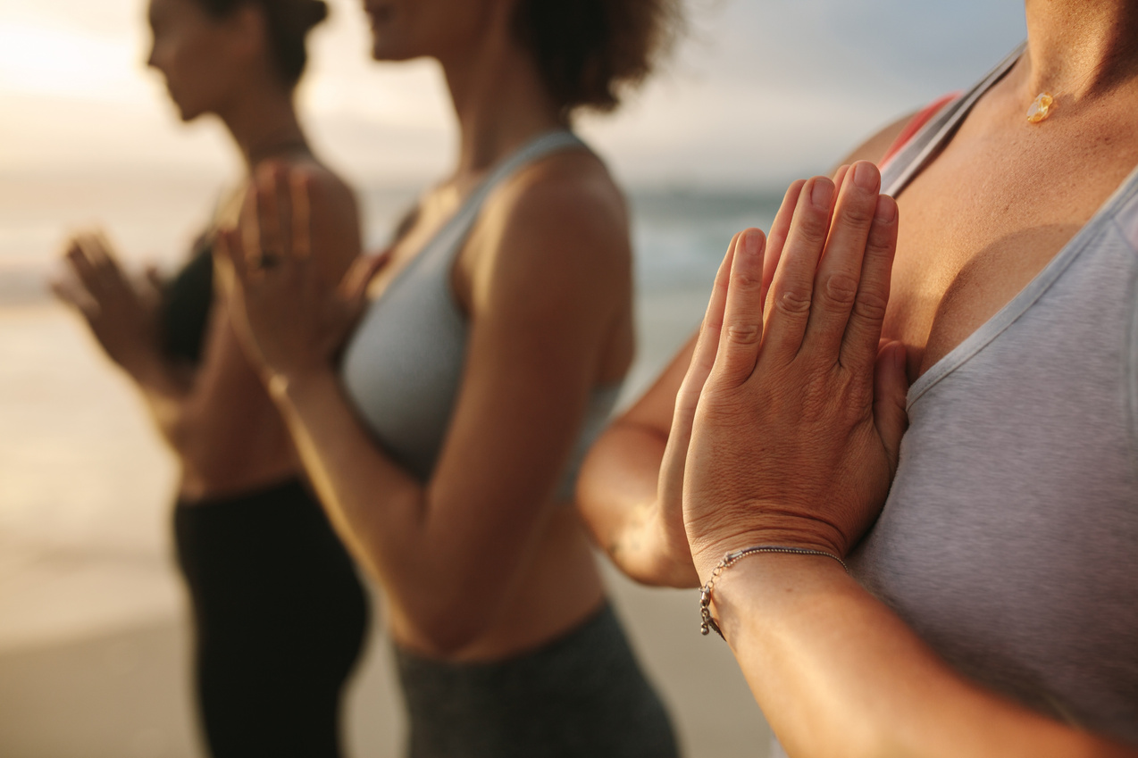
Retreats aren't just a luxury; they're a necessity in today's fast-paced
> world. Here's why
4.Creativity
5.Well Being
Creativity thrives in spaces of stillness and inspiration. Retreats provide the ideal environment for creative exploration, free from the constraints of everyday pressures. Whether through artistic endeavors, brainstorming sessions, or simply allowing our minds to wander, retreats ignite the spark of innovation and imagination.
Mental, emotional, and physical well-being are integral to our overall health. Retreats offer a holistic approach to well-being, incorporating practices such as mindfulness, yoga, meditation, and healthy living. By prioritizing self-care during retreats, we cultivate habits that sustain us long after we return to our daily routines.

Slide 9

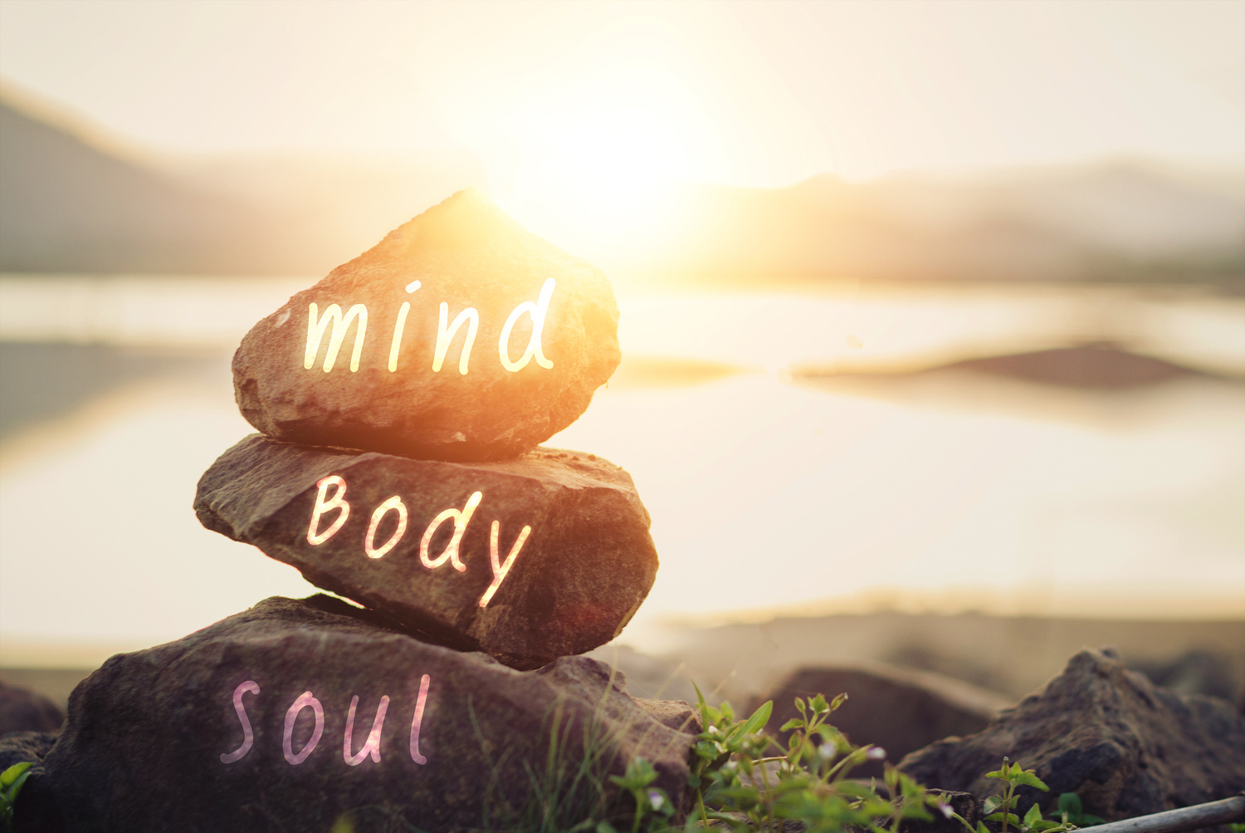
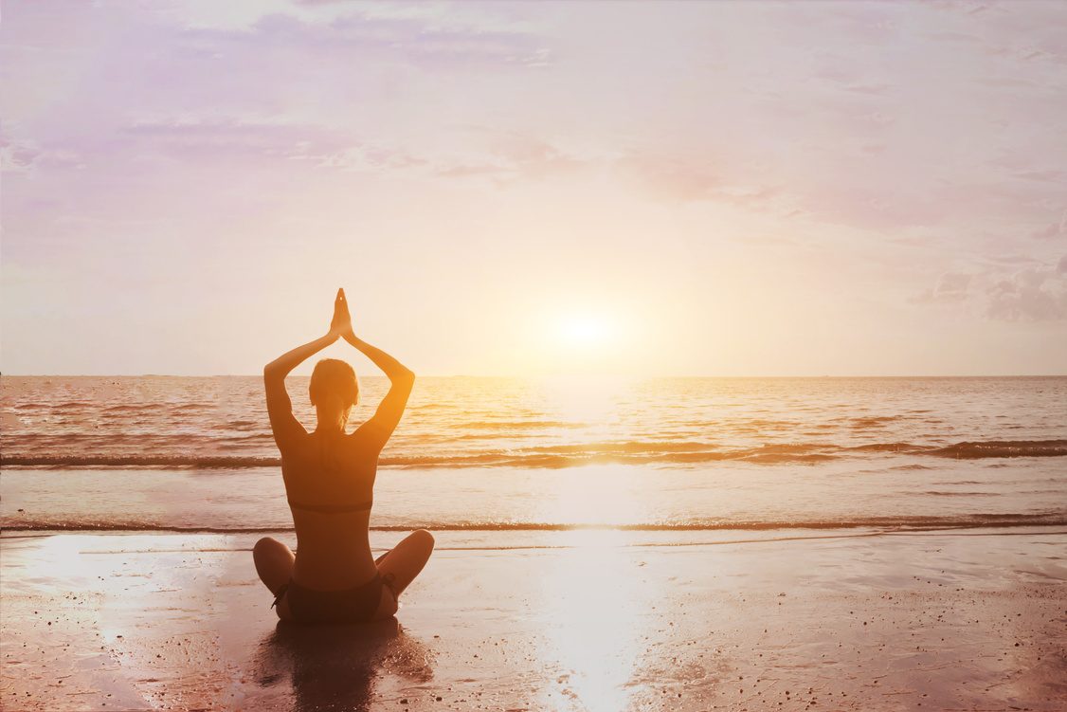
At JV Ventures, we recognize the profound benefits that retreats offer in fostering personal growth, team cohesion, and collective well-being. That's why we're committed to creating opportunities for retreat experiences that nurture mind, body, and spirit.
Join us on this journey of self-discovery, connection, and renewal by attending one of our Retreats. Together, let's embrace the transformative power of retreats and cultivate a culture of flourishing.

Slide 10
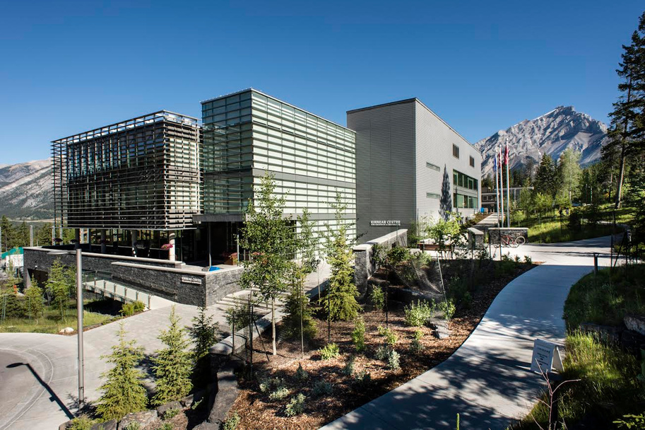
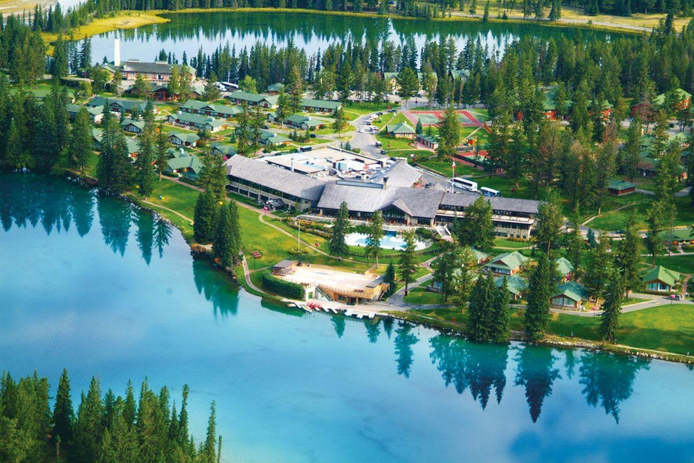


Upcoming Retreats
1.
2.
3.
Women’s Wellness Retreat
Banff Conference Centre Aug 23-25 , 2024
Mixed Wellness Retreat
Jasper Park Lodge ( JPL ) Oct 11-13, 2024
Couples Retreat
Chateau Lake Lousie Nov 8-10, 2024

Slide 11

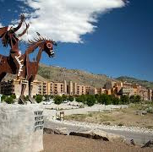
Upcoming Retreats
4.
5.
Business Retreat
Vancouver, TBA tentative April, 2025
Spirituality Retreat
Spirit Ridge Osoyoos June 20-22, 2025

Slide 12
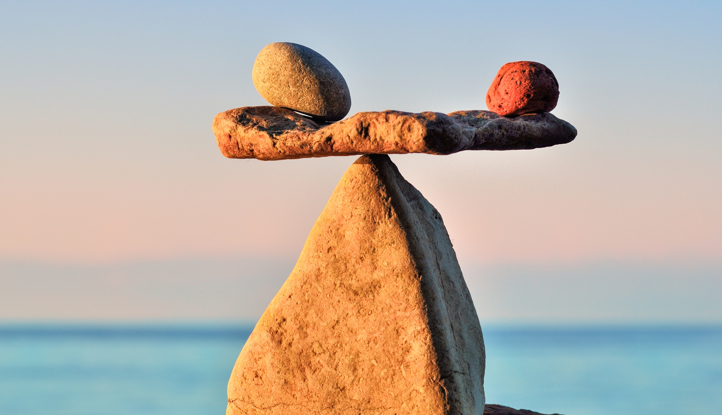
Our Mission
Our mission is simple yet profound: to inspire and empower individuals to awaken to their fullest potential and live authentically from the heart. We believe that true transformation begins from within and that each of us has the power to create the life we desire.
From transformative retreats and workshops to guided meditation sessions and personalized coaching, we offer a range of experiences designed to support you on your journey of self-discovery and empowerment.
Our approach is holistic, honoring the mind, body, and spirit, and our teachings draw upon
ancient wisdom traditions and modern psychology to create a comprehensive framework for growth and healing.

Slide 13

Our Mission
Whether you're seeking clarity, healing, or simply a deeper connection to yourself and the world around you, we invite you to join us on this sacred journey of self-discovery and awakening.
Together, let's embrace the challenges, celebrate the victories, and unlock the infinite potential that resides within each of us. Ready to embark on your own journey of transformation? Get in touch with us today to learn more about our offerings and how we can support you on your path to self-discovery and empowerment.

Slide 14

Partnership
Opportunity
Sponsorship For Wellness Retreats

Slide 15

At JV Ventures, we specialize in organizing transformative wellness retreats that offer participants a unique opportunity to rejuvenate their mind, body, and spirit in serene and rejuvenating environments.
Our retreats focus on holistic wellness practices, including yoga, meditation, mindfulness, nutrition, and outdoor activities, all aimed at promoting physical, mental, and emotional well-being.
We are currently seeking sponsors to support our upcoming wellness retreats. By sponsoring our retreats, your company would not only demonstrate its commitment to promoting wellness and healthy lifestyles but also gain valuable exposure and brand visibility among our diverse and engaged audience.

Slide 16

Why You Should Sponsor
1. Brand Exposure:
Your logo and branding will be prominently featured
in our promotional materials, including event signage, marketing collateral, and social media channels, reaching thousands of potential customers who are passionate about wellness.
2. Networking Opportunities:
As a sponsor, [Company Name] will have the
opportunity to connect with like-minded individuals and organizations within the wellness community, fostering valuable relationships and potential business partnerships.

Slide 17

Why You Should Sponsor
3. Positive Brand Association:
Aligning your brand with our wellness retreats will enhance your reputation as a socially responsible company that prioritizes the well-being of its customers and employees.
4. Customized Partnership Packages:
We offer flexible sponsorship packages tailored to meet the specific needs and objectives of our partners, ensuring that [Company Name] receives maximum value and return on investment.

Slide 18
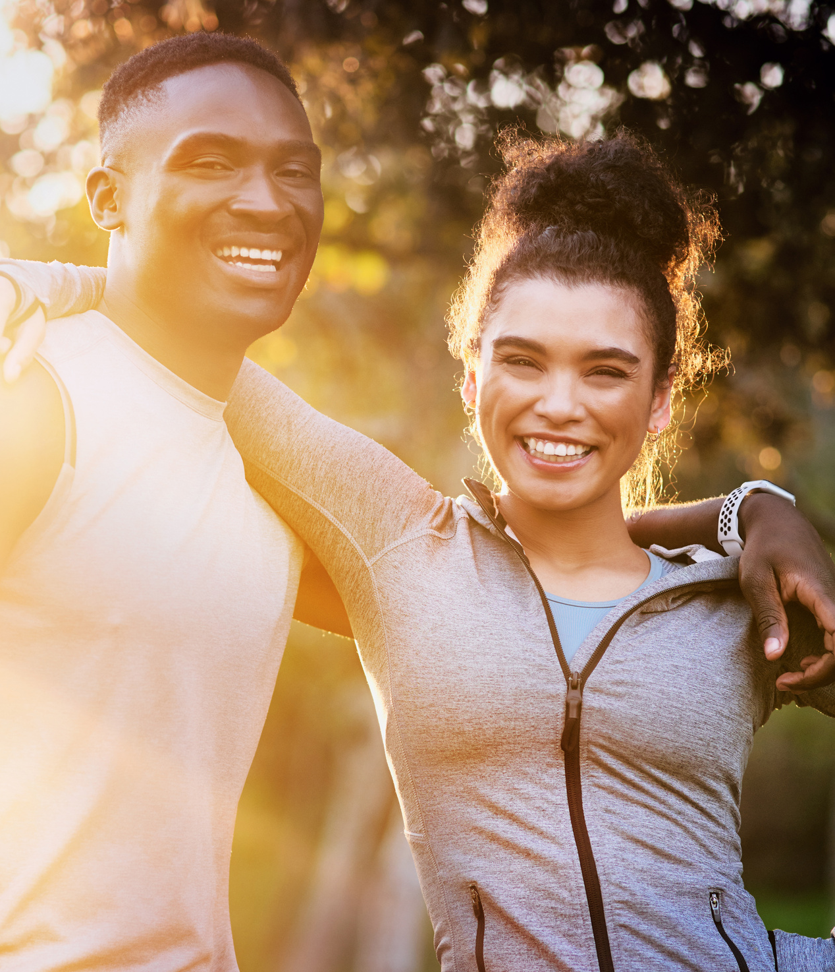
We believe that a partnership between your company and JV Ventures has the potential to create a mutually beneficial relationship that not only promotes wellness but also generates positive brand exposure and fosters community engagement.
We would love the opportunity to discuss this partnership further and explore how we can work together to create meaningful and impactful wellness experiences for our participants.
Please feel free to reach out to me us to schedule a meeting or discuss any questions you may have.
Thank you for considering this partnership opportunity. We look forward to the possibility of working together to inspire and empower individuals to live happier, healthier lives, while positively impacting those around them
> at home and work.

Slide 19

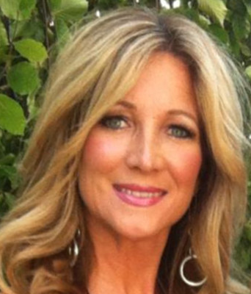
Thank You!
Contact:
info@jvventures.ca
780-993-9714

